Slide 1
“Computational Power and AI”
By Jai Vipra + Sarah Myers West AINOW.
Prof. David Andrews
Rm 527 JBHT
https://ainowinstitute.org/wp-content/uploads/2023/09/AI-Now_Computational-Power-an-AI.pdf

Slide 2
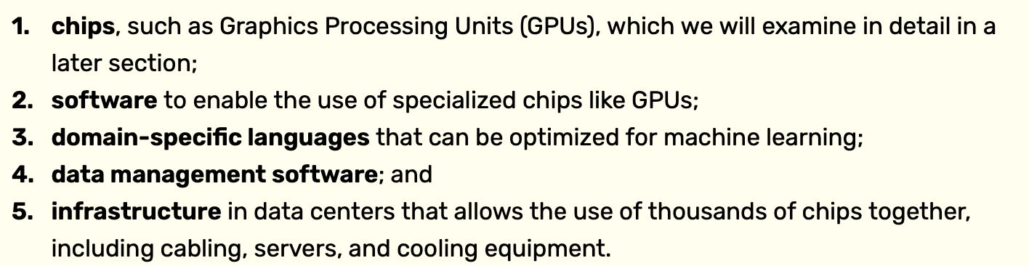
Defining Compute

Slide 3
Core Thesis of the Article
Compute is not just a technical input, it is a structuring force for:
  Market power
  Research direction
  Environmental impact
  Governance and policy
Current approach to AI infrastructure self perpetuating, not sustainable long term.
New Policies may be required to prevent hurtful monopolies

Slide 4
AI Dominance
Compute is a predominant factor driving the industry today. Industry spends more than 80% of total capital spent on compute resources.
Incentivizes cloud infrastructure providers to act in ways that protect their dominant position in the market
Encourages lock-in into their cloud ecosystems.
Reinforaces the control of firms that already dominate the tech industry.
The rich get richer…….

Slide 5
Approach to AI to date:
Researchers in AI have largely concluded that increasing scale is key to accuracy and performance in training deep learning models. This has driven an exponentially growing demand for compute power, leading to concerns that the current pace of growth is unsustainable

Slide 6
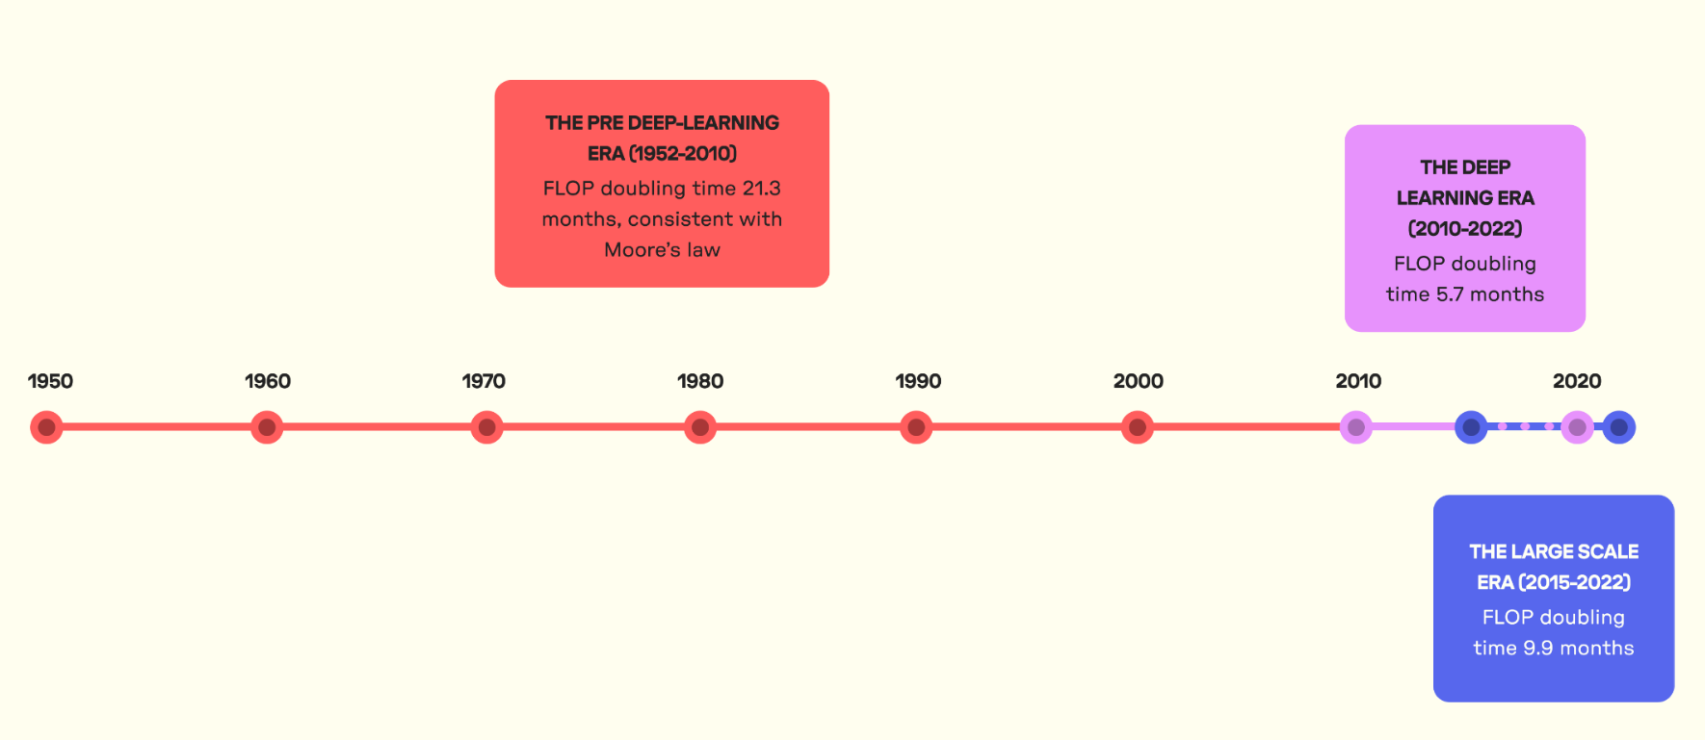
Compute Demand Growth
Pre Deep Learning Era: Compute for AI Models Doubled ~ 21 Months
Deep Learning Era (~2010): Doubled ~5.7 Months
Since 2015: Large-Scale Models Doubled ~9.9 Months
Regular-Scale Models Doubled ~5.7 Months

Slide 7
Effects of Demands
Demand for Limited Supply of Chips Extremely high
  Orgs set up to provide GPU rental services
  Purchases of GPUs by nation-states seeking competitive advantage
Puts a few in Dominant Positions:
  Cloud infrastructure firms (AWS, Google Cloud, MSAzure)
  Chips: NVIDIA
  Chip Fab: TSMC
And unsustainable environmental issues
  TSMC accounts for 4.8% of Taiwan’s national energy consumption, more than the entire capital city of Taipei

Slide 8
Self Perpetuating Cycles
Accepted Scaling Assumption
Bigger models + more compute = better results
Industry consensus shaped investment
Reinforces large‑scale, centralized approaches

Slide 9
Self Perpetuating Cycles
Compute infrastructure evolved to support growth of large language models
  Hardware Lottery: a research idea wins because it is the most suited to the available hardware and software.
=> self perpetuating cycle:
LLMs => bigger models => increased infrastructure => bigger models ….
Cost of straying from mainstream hardware compatability will increase

Slide 10
Self Perpetuating Cycles
Not just hardware but software infrastructure
  Businesses invest and rely on stable software infrastructure
    Resistance to retraining software developers
    Resistance to “reving” up legacy code
    Resistance to purchasing new soft. Infrastructure
Corporate Allegiance to the status quo

Slide 11
GPU as ML ISA
CUDA defines algorithm design
  Resists Growth of Alternative Algorithmic Approaches
    Small Language Models ?
Software lock-in reinforces hardware dominance
    Corporations resist switching to alternative hardware base.
PyTorch opensource initiative under Linux foundation funded by Meta

Slide 12
And the cycle continues
More Demand causing shortage of GPUs
Start-ups enter AI race by making contractual arrangements with Big Tech firms.
  Grows dominance of existing firms
  Google touted 70% of generative AI startups use Google cloud facilities.
Big Tech Firms
  Need for more compute shaping future product decisions.

Slide 13
Limits Innovation
Architectures mapping well to GPUs do not just succeed but proliferate
Alternatives lose mindshare
  Modern day equivalent of resisting architectural novelty by relying on performance increases from Moore’s Law

Slide 14
Large-Scale AI Models
How Much Compute and What Does it Cost
At current growth rate: Compute costs in excess of entire US GDP by 2037
Training GPT-4 “Probably” More than ~$100 Million

Slide 15
Chips for large-scale AI
GPUs
  Dominance in Training
Field Programmable Gate Arrays (FPGAs)
  Arguments for:
    Energy Efficiency
    Flexibility
  Arguments Against:
    Lower Density/Performance
    Lack of Software Centric Protocol Stack
ASICs
  Cost
  Software Infrastructure
  Time to Market

Slide 16
Components of Computer Hardware
Logic
Memory
Interconnect
In traditional CPUs, memory tends to account for over half the cost of a server setup. (badly worded in paper). The cost of GPUs has memory seem cheaper ☺

Slide 17
Quantitative Reality: Energy per Operation
FP16 MAC: ~1–2 pJ
SRAM access (32b): ~5–10 pJ
DRAM access (32b): ~100–1000 pJ
Arithmetic is effectively free
Data movement dominates energy

Slide 18
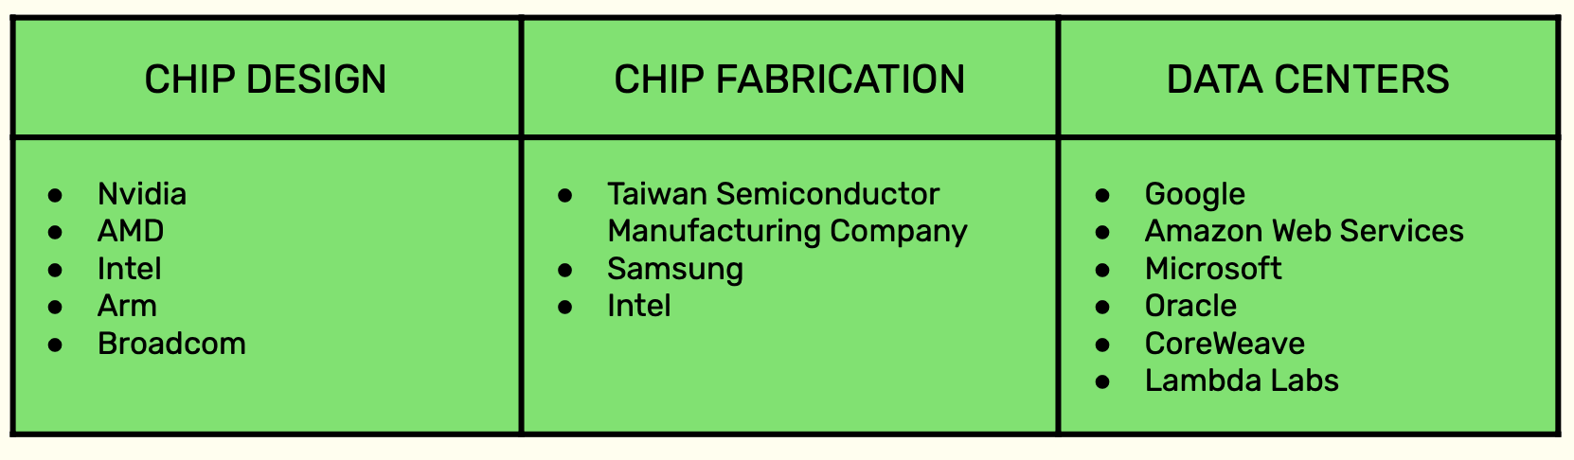
Supply Chain for AI Hardware
Google: TPU used to develop Google Gemini: software/hardware
integration impacts entire ecosystem leading to stronger monopolization
Microsoft: Athena => Maia 100 => Maia 200
3 nm node FP8/FP4 cores, 216GB HBM3e at 7 TB/s and 272MB of on-chip SRAM
AWS: Trainium

Slide 19
Market Dominance
Data Centers:
  NVIDIA 92 -98% of Data Center Market
  AMD 8- 2%
  Intel < 1%
Overall GPU Market:
  NVIDIA 94%
  AMD ~6%

Slide 20
New Entries
Cerebras: Wafer Scale Integration
  Bandwidth 10,000x wrt NVIDIA GPUs
Rain: Neuromorphic Architecture
Groq; ”Partnership” with NVIDIA
  Groq hardware + CUDA infrastructure ?

Slide 21
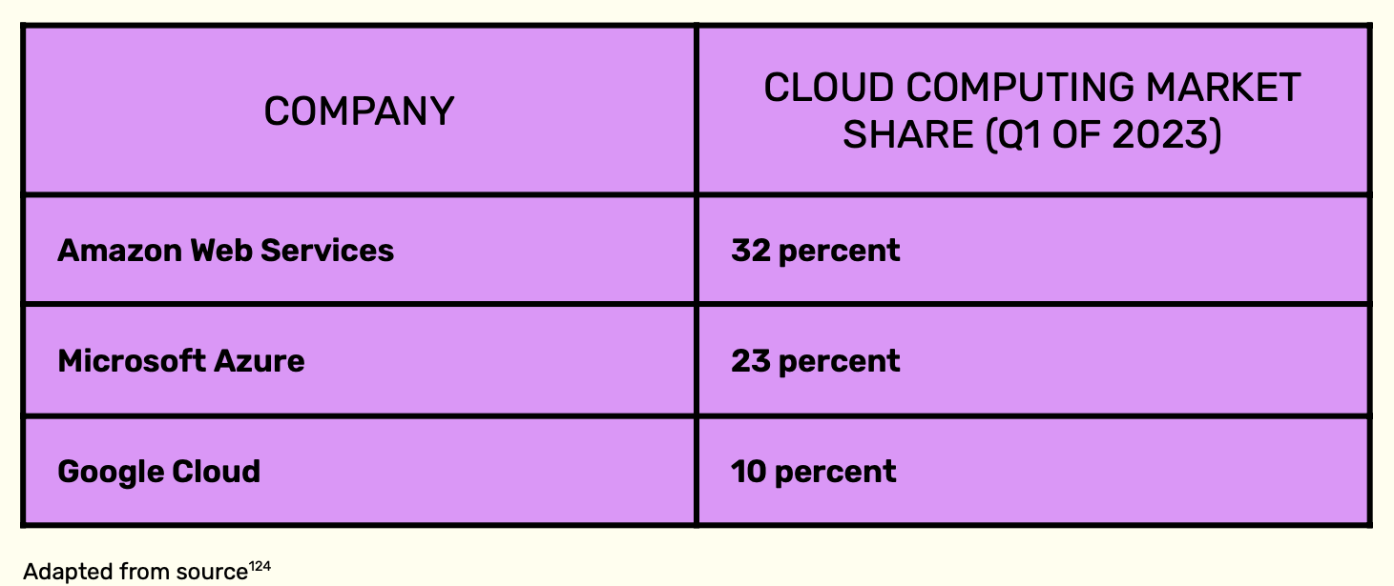
Investments in Self Interest
Microsoft invested in OpenAI, Azure exclusive provider for OpenAI.
Microsoft AI Supercomputers built for OpenAI

Slide 22
Investments in Self Interest
Google Brain Team and DeepMind fully integrated into Google DeepMind.
Amazon entered into partnerships with open source model developers and platforms.

Slide 23
Investments in Self Interest
Oracle offers compute credit to AI startups
Cloud companies invest in AI service companies

Slide 24
How to Reduce Compute Costs
Don’t Count on Moore’s Law ☺
New Algorithms: Smaller Models
Paradigm Shifts and Breakthroughs
  Memory bottleneck: New Memory Technology could provide significant breakthrough.
  New Heterogeneous Technologies: Nanotech + CMOS
  New Architectures: Processor in Memory (PIM), Neuromorphic, Quantum, analog computing architectures

Slide 25
Policy considerations
Antitrust: Continued Vertical Integration reinforces Hardware Lottery grip:
  Separate Cloud Provision from Chip Design
  Separate Hardware from Software, or mandate interoperability
  Separate AI Model Development from Cloud Infratructure
  Institute Nondiscrimination or Common Carier Obligations Across Tech Stack
  Prevent Further Market Concentration
  Investigate Anticompetitive Conduct
  Apply Existing Antitrust Principles to AI Compute Markets

Slide 26
Data Minimization
Data and Compute are separate inputs to AI.
  Scaling laws limit amount of data that can be efficiently used with a given amount of compute, exclusive data access becomes increasingly important as freely available internet data runs out.
    Freely available data already used
    Newly produced data is starting to be protected by more platforms.
      Reddit, Twitter have implemented protections against free use of data from their platforms.
      Relative value of internet data declining as it features more AI-generated content.

Slide 27
Data Minimization
Embrace data-minimization mandates, prohibit collection/processing of sensitive data
Prohibit secondary use of data collected from consumers for training AI models as violation over consumer control of personal data.

Slide 28
Bandwidth Wall
HBM ~3–6 TB/s per package
On-chip demand growing faster than bandwidth
Utilization collapses without locality

Slide 29
Roofline Perspective
Compute-bound vs memory-bound regimes
Most ML kernels are bandwidth-bound

Slide 30
Scaling Laws vs Hardware
Model scaling hides inefficiency
More parameters compensate for poor locality

Slide 31
Memory Hierarchy Constraints
Limited SRAM per PE
Expensive off-chip accesses
HBM capacity ceilings

Slide 32
Quantitative SRAM Limits
SRAM density ~0.5–1 MB/mm²
Large models cannot fit on-chip

Slide 33
DRAM Energy Cost
~2 orders of magnitude > MAC
Dominates inference at scale

Slide 34
Why Memory-Centric Compute
Reduce data movement
Exploit locality
Energy proportionality

Slide 35
Near-Memory Compute
Logic in HBM base die
Lower latency
Limited flexibility

Slide 36
Processing-in-Memory (PIM)
Analog or digital compute in memory
Massive bandwidth
Precision and programmability tradeoffs

Slide 37
Quantitative PIM Potential
10–100× energy reduction (kernel-dependent)
Workload constrained

Slide 38
CGRA Overview
Spatial arrays
Explicit dataflow
Compiler-scheduled

Slide 39
CGRA Strengths
High utilization
Energy efficiency
Regular workloads

Slide 40
CGRA Limitations
Toolchain complexity
Irregular control flow

Slide 41
FPGA Overview
Reconfigurable fabric
Custom datapaths
On-chip SRAM blocks

Slide 42
FPGA Strengths
Flexibility
Custom memory hierarchies
Streaming dataflows

Slide 43
FPGA Limitations
Lower clock rates
Routing overhead
Programming difficulty

Slide 44
Comparison: GPU vs ASIC vs FPGA vs CGRA vs PIM
GPU: flexible, inefficient
ASIC: efficient, inflexible
FPGA: flexible dataflow
CGRA: spatial efficiency
PIM: bandwidth-first

Slide 45
Energy Efficiency Comparison
ASIC > CGRA > FPGA > GPU
PIM best for limited ops

Slide 46
Programmability Comparison
GPU easiest
FPGA/CGRA hardest
PIM kernel-specific

Slide 47
Memory Proximity Comparison
PIM highest
FPGA/CGRA moderate
GPU lowest

Slide 48
Why Alternatives Struggle
Hardware lottery
Software ecosystem gravity
Capital barriers

Slide 49
Implications for Architects
Efficiency is strategic
Memory-centric design is governance

Slide 50
Future Directions
HBM-PIM hybrids
Reconfigurable memory fabrics
Algorithm-hardware co-design

Slide 51
Research Opportunities
Compiler-driven locality
Sparse and structured models
Dataflow-native ML

Slide 52
Relevance to ASIC-Competitive FPGAs
Custom memory per tile
Tight compute-memory coupling
Reduced routing overhead

Slide 53
Key Takeaway
AI futures are decided in silicon
Memory is the battleground

Slide 54
Discussion Questions
Should compute be regulated as infrastructure?
How do we fund architectural diversity?

